Slide 1
Core Methods in Educational Data Mining
EDUC 6191 Fall 2022

Slide 2
Final project
Let’s take a few minutes to discuss the final project
One month away
The end of the semester is creeping up on us

Slide 3
Final project
Let’s go over the assignment
Most important things to note
You need a project group of 2-3
You present an idea
You do not conduct an analysis between now and December 15

Slide 4
Final project
Finding teammates
Some of you have been ultra-proactive and have already found teammates
For those of you who haven’t, I recommend posting to the final-project folder on piazza
Suggest an idea you’re potentially interested in to your classmates
Read their ideas
If you haven’t found project partners by Thanksgiving, send me an email and I’ll see if I can connect people

Slide 5
Final project
Any questions?

Slide 6
What is Deep Learning?

Slide 7
What is Deep Knowledge Tracing?

Slide 8
An overly brief introduction to neural networks

Slide 9

The classic perceptron
A perceptron takes a set of inputs
Has a weight for each input
Multiplies those weights by the inputs
Adds it all together
Adds an intercept
And then applies a step function to get {0,1}

Slide 10
For example
We have inputs M, N, P
With w weights 1, 0, -0.5 and b intercept 0.1
Then for M=1, N=-7, P=2
What is f(x)?

Slide 11
For example
We have inputs M, N, P
With w weights 1, 0, -0.5 and b intercept 0.1
Then for M=-1, N=0.003, P=8
What is f(x)?

Slide 12
But actually
Usually modern neural networks use more complex decision functions than just a step function
Logistic function
Tanh function
ReLu function
If x>0, x
If x<=0, 0
And many more

Slide 13
That’s one perceptron
And one perceptron can have multiple inputs

Slide 14
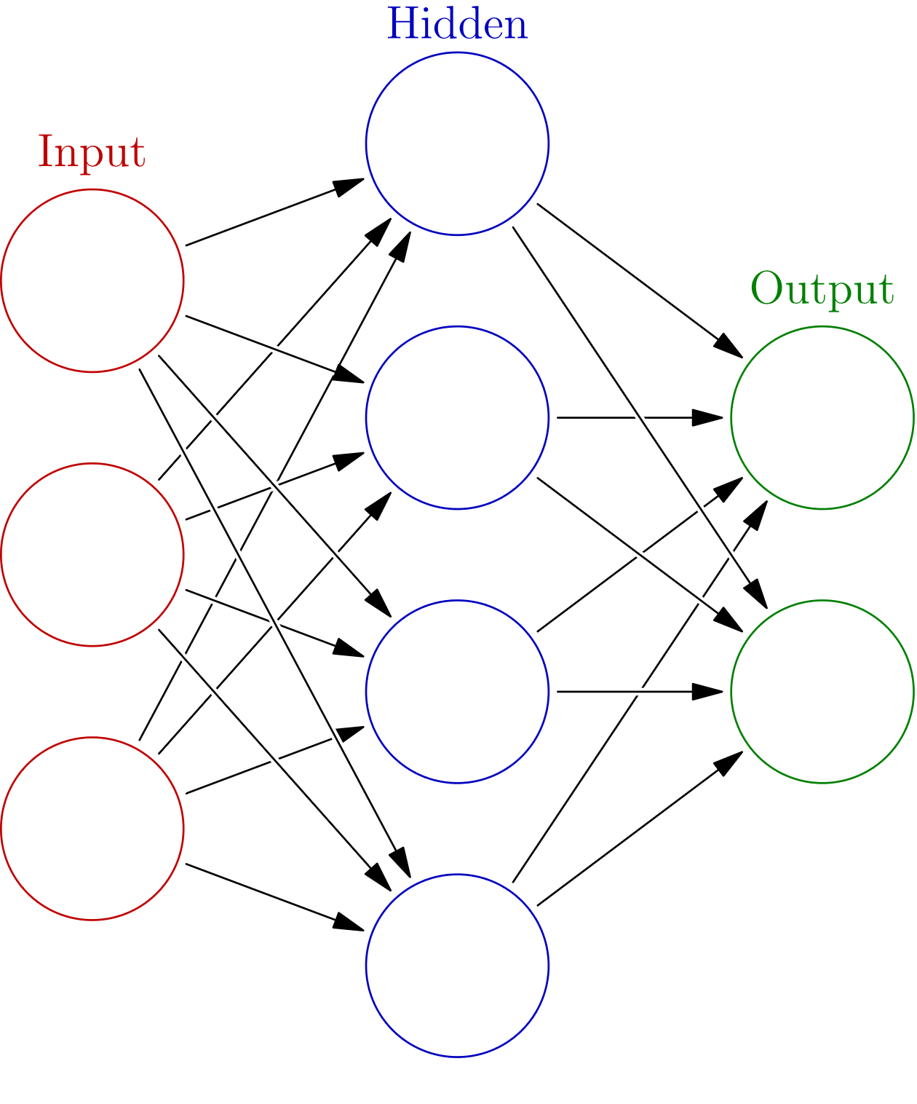
But…
But neural networks take a lot of inputs and they can produce multiple outputs
Image courtesy of glosser.ca used under Creative Commons Licensing

Slide 15
Neural network
Red circles: Predictors
Blue circles: Perceptrons
Green circles: Predicteds
Image courtesy of glosser.ca used under Creative Commons Licensing

Slide 16
What you see here
A single layer neural network
A very simple one
Generally hundreds/thousands/ millions of hidden perceptrons
Image courtesy of glosser.ca used under Creative Commons Licensing

Slide 17
But this is just a simple single-layer neural network
Image courtesy of glosser.ca used under Creative Commons Licensing

Slide 18
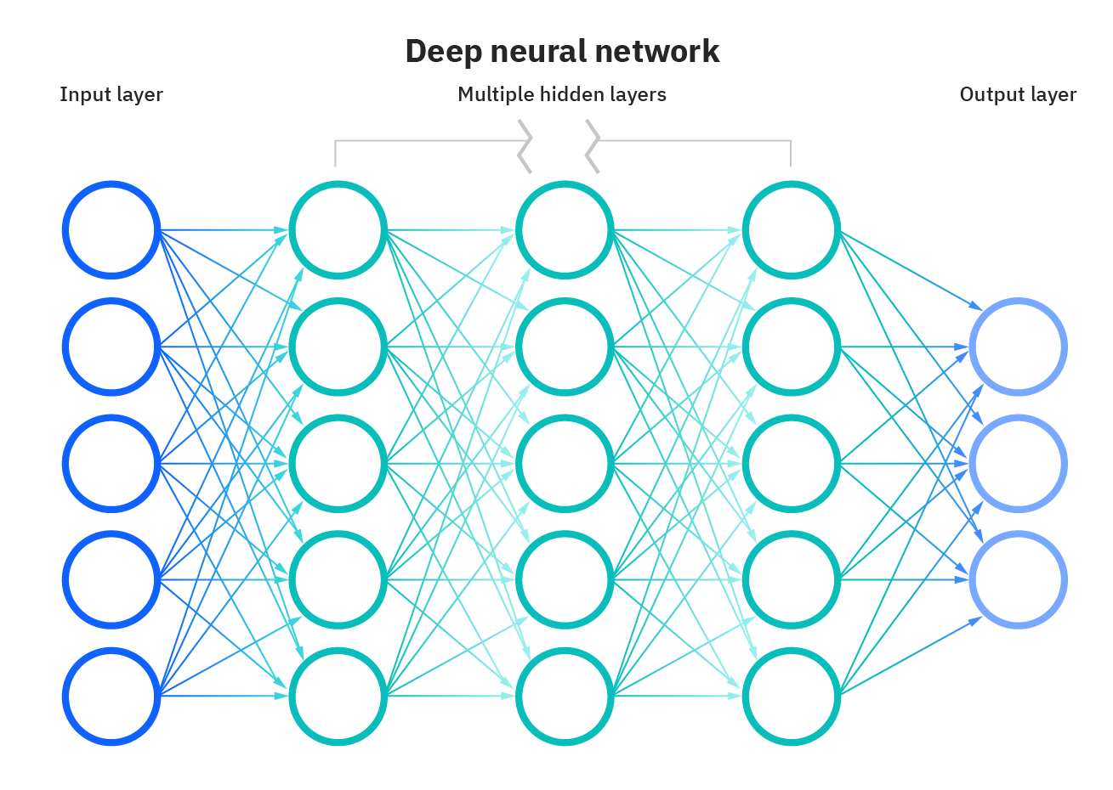
On to deep learning
Image courtesy of IBM

Slide 19
Multiple hidden layers
Image courtesy of IBM

Slide 20
Why does deep learning (sometimes) work better?
Can capture multiple layers of abstraction
Without having to do so in a way that human beings can understand

Slide 21
Any questions?

Slide 22
And…
Lots of ways to make things more complex still

Slide 23
Often the term deep learning
Reserved for recurrent neural networks (or more complex algorithms still)
Recurrent neural networks fits on sequence of events
Keeping some degree of “memory” about previous events

Slide 24
Recurrent neural networks (RNN)
Feed back information from later layers back to earlier layers
A node can (over time) influence itself
Allows for sequence of outputs

Slide 25
Long short term memory networks
RNN variant
Replaces perceptrons with LSTM units
Information propagation reduces over time for given piece of information (long-term memory)
Activation patterns in network change once per time step (short-term memory)
Will not go into full details; linear algebra required

Slide 26
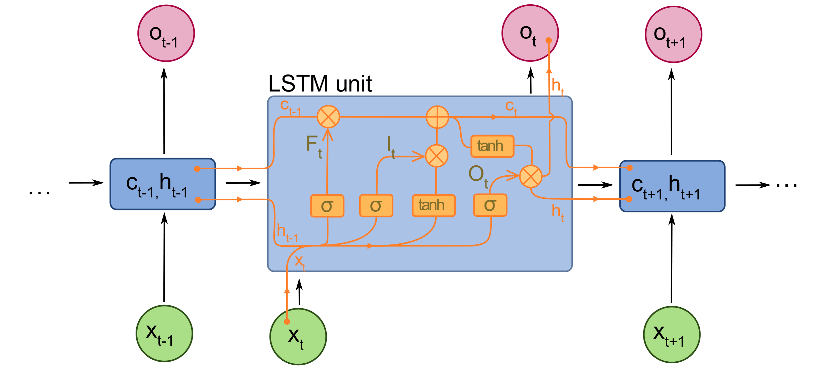
LSTM Unit
Note the:
Hidden state (h) Forget gate (Ft)
Input gate (It) Output gate (Ot)
Image by fdeloche - CC BY-SA 4.0

Slide 27
Any questions?

Slide 28
Deep Knowledge Tracing (Piech et al., 2015)
Finally
Predict student correctness… with an LSTM!

Slide 29
DKT
Initial paper reported massively better performance than original BKT or PFA (Piech et al., 2015)
Seemed at first too good to be true, and (Xiong et al., 2016) reported that (Piech et al., 2015) had used the same data points for both training and test

Slide 30
DKT
(Khajah et al., 2016) compared DKT to modern extensions to BKT on same data set
Particularly beneficial to re-fit item-skill mappings
(Wilson et al., 2016) compared DKT to temporal IRT on same data set
Bottom line: All three approaches appeared to perform comparably well

Slide 31
Beginning of what could be called DKT-Family algorithms
A range of knowledge tracing algorithms based on different variants on Deep Learning
Now literally hundreds of published variants
Most of them tiny tweaks to get tiny gains in performance
I will discuss some of the key issues that researchers have tried to address, and what their approaches were

Slide 32
Degenerate behavior
(Yeung & Yeung, 2018) report degenerate behavior for DKT
Getting answers right leads to lower knowledge
Wild swings in probability estimates in short periods of time

Slide 33
Degenerate behavior
(Yeung & Yeung, 2018) report degenerate behavior for DKT
Getting answers right leads to lower knowledge
Wild swings in probability estimates in short periods of time
They proposed adding two types of regularization to moderate these swings
Increasing weight of current prediction for future prediction
Reducing amount model is allowed to change future estimates

Slide 34
Questions? Comments?

Slide 35
Impossible to interpret in terms of skills
DKT Family predicts individual item correctness, not skills
What do you do for entirely new items?
What information can you provide teachers?

Slide 36
Extension for Latent Knowledge Estimation
(Zhang et al., 2017) propose an extension to DKT, called DKVMN, that fits an item-skill mapping too
Based on Memory-Augmented Neural Network, that keeps an external memory matrix that neurons update and refer back to
Latent skill difficult to interpret

Slide 37
Extension for Latent Knowledge Estimation
(Lee & Yeung, 2019) propose an alternative to DKT, called KQN, that attempts to output more interpretable latent skill estimates
Again, fits an external memory network to fit skills
Also attempts to fit amount of information transfer between skills
Still not that interpretable

Slide 38
Extension for Latent Knowledge Estimation
(Scruggs et al., 2020) propose an extension to any DKT-family algorithm
Human-derived skill-item mapping used
Predicted performance on all items in skill averaged
Including both unseen and already-seen items
Leads to successful prediction of post-tests outside the learning system

Slide 39
Questions? Comments?

Slide 40
What is DKT really learning?
Ding & Larson (2019) demonstrate theoretically that a lot of what DKT learns is how good a student is overall

Slide 41
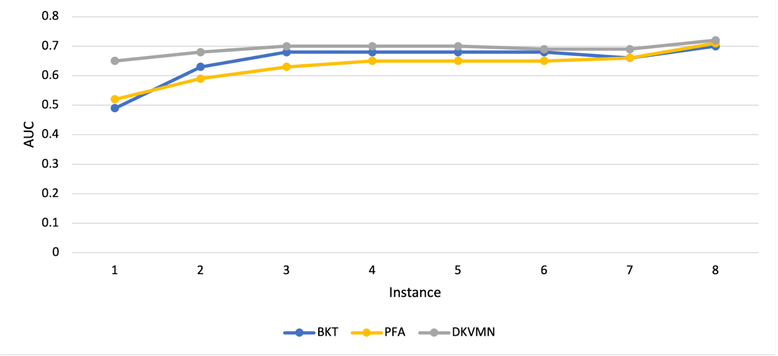
What is DKT really learning?
Zhang et al. (2021) follow this up with empirical work showing that most of the improvement in performance for DKVMN is in the first attempt on a new skill

Slide 42
What is DKT really learning?
In particular, there’s essentially no benefit to deep learning after several attempts on a skill (about the point where students often reach mastery, if they didn’t already know skill)

Slide 43
Questions? Comments?

Slide 44
Other Recent DKT variants: SAKT
Pandey & Karypis (2019) propose a DKT variant, called SAKT, which fits attentional weights between exercises and more explicitly predicts performance on current exercise from performance on past exercises
Gets a little better fit, doubles down a little more on some limitations we’ve already discussed

Slide 45
Other Recent DKT variants: SAKT
Incidentally, Pandey & Karypis (2019)’s abstract doesn’t match what they actually do
Abstract claims they find relationship between KC
And then one sentence in paper
“For predicting student’s performance on an exercise, we used exercises as KCs.” (p.2)

Slide 46
Other Recent DKT variants: AKT
Ghosh et al. (2020) propose a DKT variant, called AKT, which
Explicitly stores and uses learner’s entire past practice history for each prediction
Uses exponential decay curve to downweight past actions
Uses Rasch-model embeddings to calculate item difficulty

Slide 47
Questions? Comments?

Slide 48
Adding in more information: SAINT+
Shin et al. (2021) add elapsed time and lag time as additional inputs to SAINT+
Additional information leads to better performance
Paper is unfortunately vague as to whether current action’s time variables are included in calculation, or just previous actions

Slide 49
Adding in more information: Process-BERT
Scarlatos et al. (2022) add timing and use of resources such as calculator
Additional information leads to better performance

Slide 50
Comments? Questions?

Slide 51
Curious methodological note
Most DKT-family papers report large improvements over previous algorithms, including other DKT-family algorithms
Improvements that seem to mostly or entirely dissipate in the next paper

Slide 52
Some reasons
Poor validation and over-fitting
A lot of DKT-family papers don’t use student-level cross-validation
Poor cross-validation benefits DKT-family algorithms more than other algorithms, because DKT-family fits more aggressively
A lot of DKT-family papers fit their own hyperparameters but use past hyperparameters for other algorithms

Slide 53
An evaluation
Gervet et al. (2020) compares KT algorithms on several data sets
Key findings
Different data sets have different winners
DKT-family performs better than other algorithms on large data sets, but worse on smaller data sets
DKT-family algorithms perform worse than LKT-family on data sets with very high numbers of practices per skill (i.e. language learning)
DKT-family algorithms do better at predicting if exact order of items matters (which can occur if items within a skill vary a lot)
DKT-family algorithms reach peak performance faster than other algorithms (as in Zhang)

Slide 54
DKT-family: work continues
Dozens of recent papers trying to get better results by adjusting the deep learning framework in various ways

Slide 55
Next Frontier for DKT-family: Beyond Correctness
Option Tracing (Ghosh et al., 2021) extends output layer to predict which multiple choice item the student will select

Slide 56
Next Frontier for DKT-family: Beyond Correctness
Open-Ended Knowledge Tracing (Liu et al., 2022) integrates KT with
A GPT-2 model fine-tuned on 2.1 million Java code exercises and written descriptions of them
In order to generate predicted student code which makes predicted specific errors

Slide 57
Questions? Comments?

Slide 58
Discussion (if there’s time)
What additional information could be useful to add as inputs?
How could we go further in what we predict?

Slide 59
Final thoughts and comments

Slide 60
Upcoming Classes
November 17
Knowledge Structure Discovery
No assignment due
November 22 SPECIAL DAY
ALL VIRTUAL CLASS
NO RYAN OFFICE HOURS
Cluster Analysis
Creative: Knowledge Structure due
December 1
ALL VIRTUAL CLASS
NO RYAN OFFICE HOURS
Correlation Mining
Basic: Clustering due

Slide 61
The End

